Slide 1
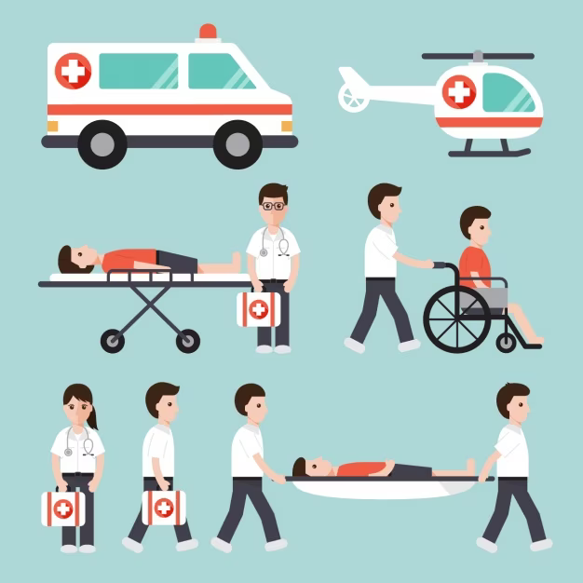
The inconvenience of accidents
How to avoid further injury
during the transportation phase?
Skeleton - Thilo Müller, Robin Frasch, Oliver Zernikow

Slide 2
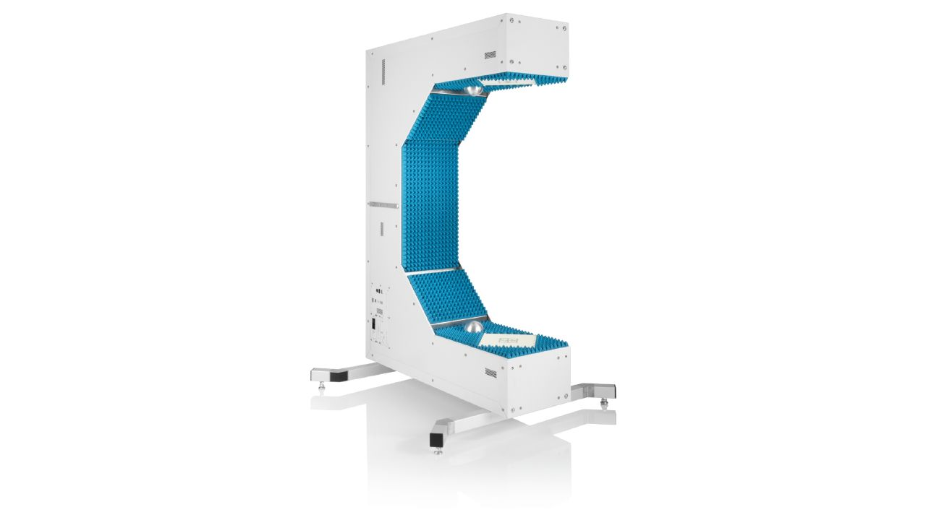

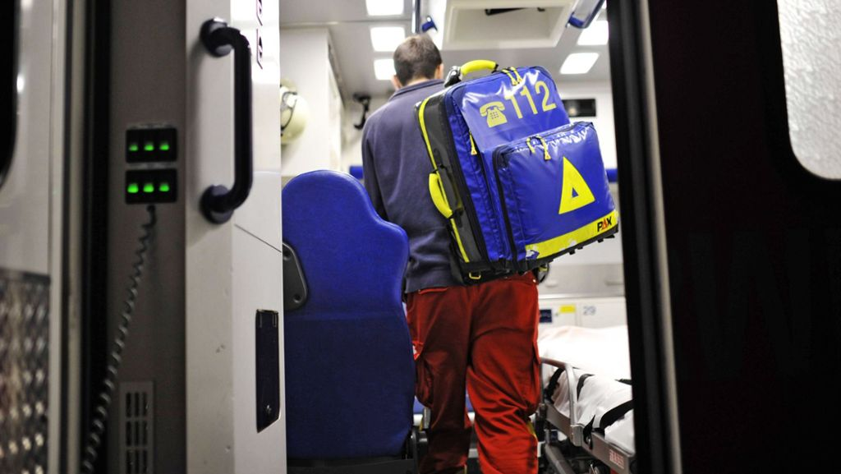

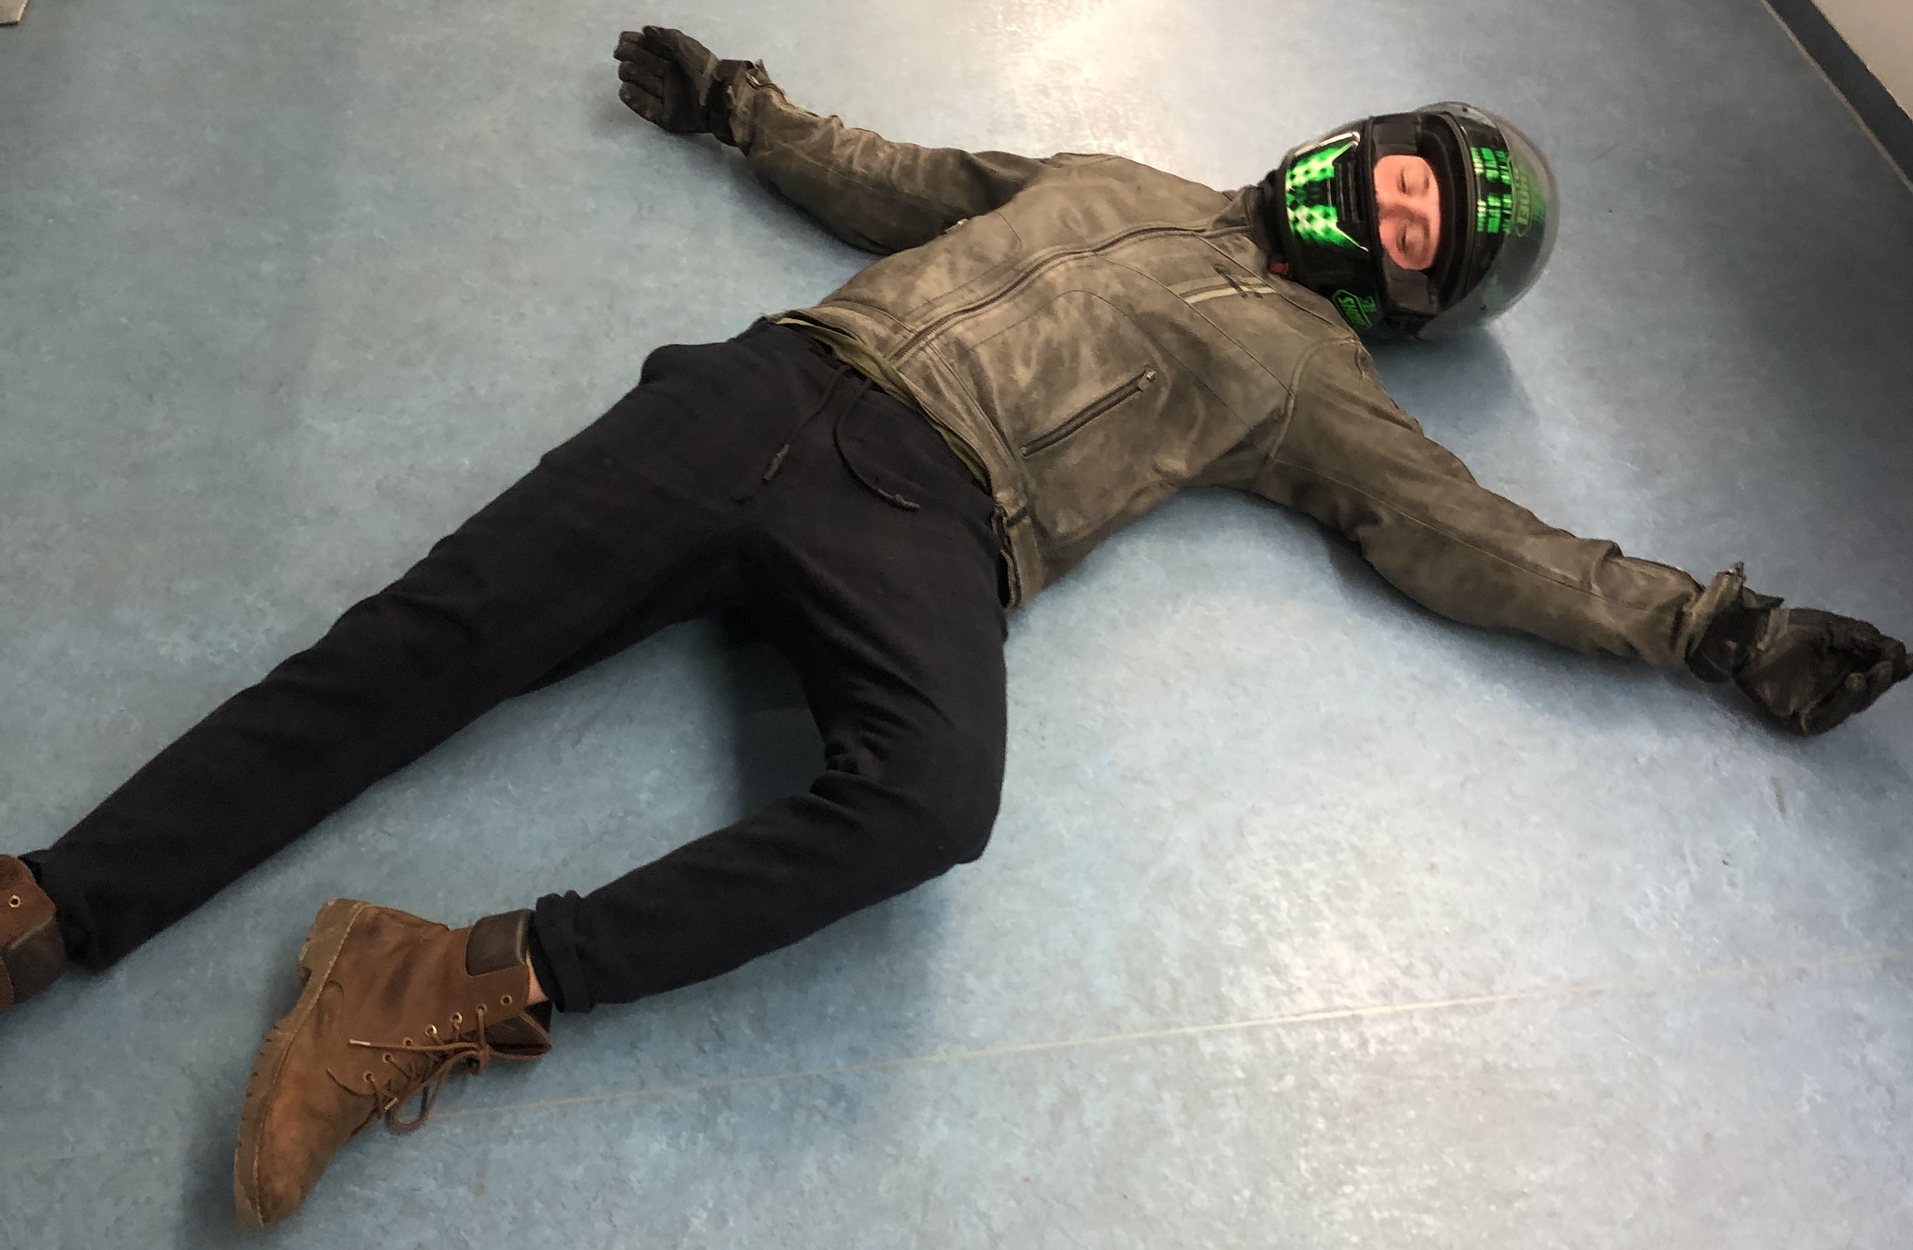
Vision – portable QAR50

Slide 3
What if an injury is covered by clothing?

Slide 4
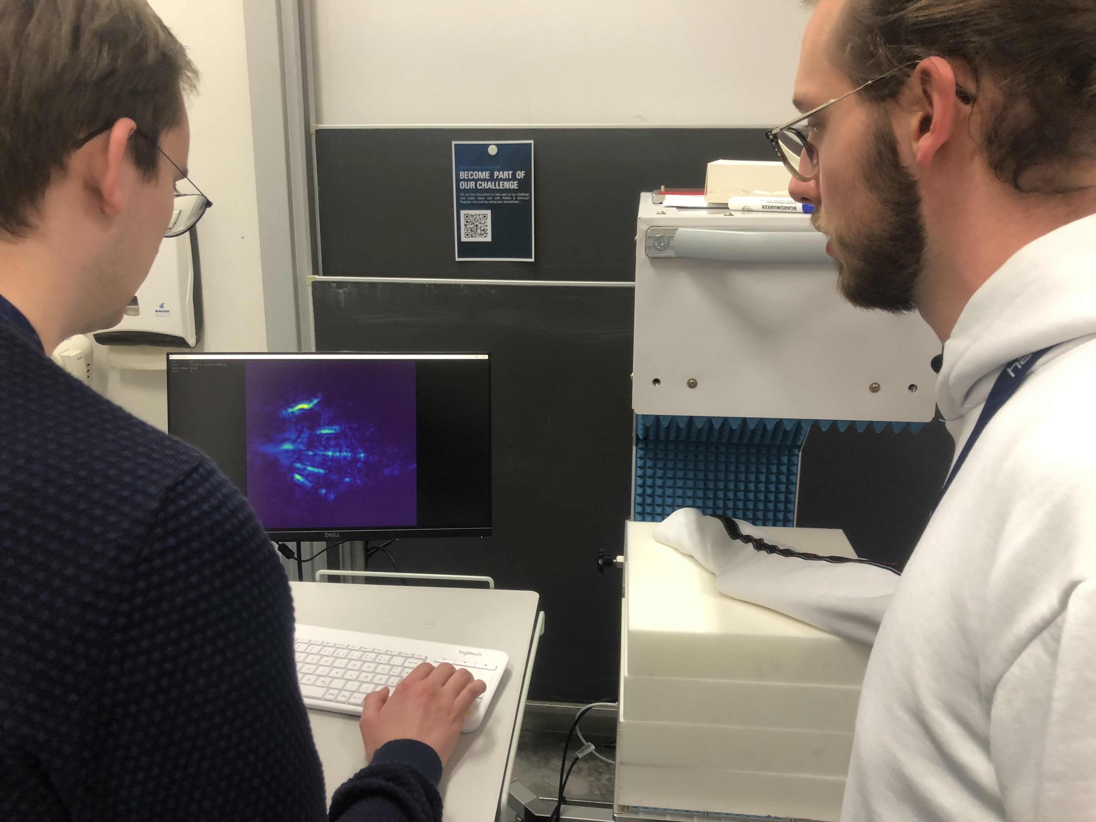
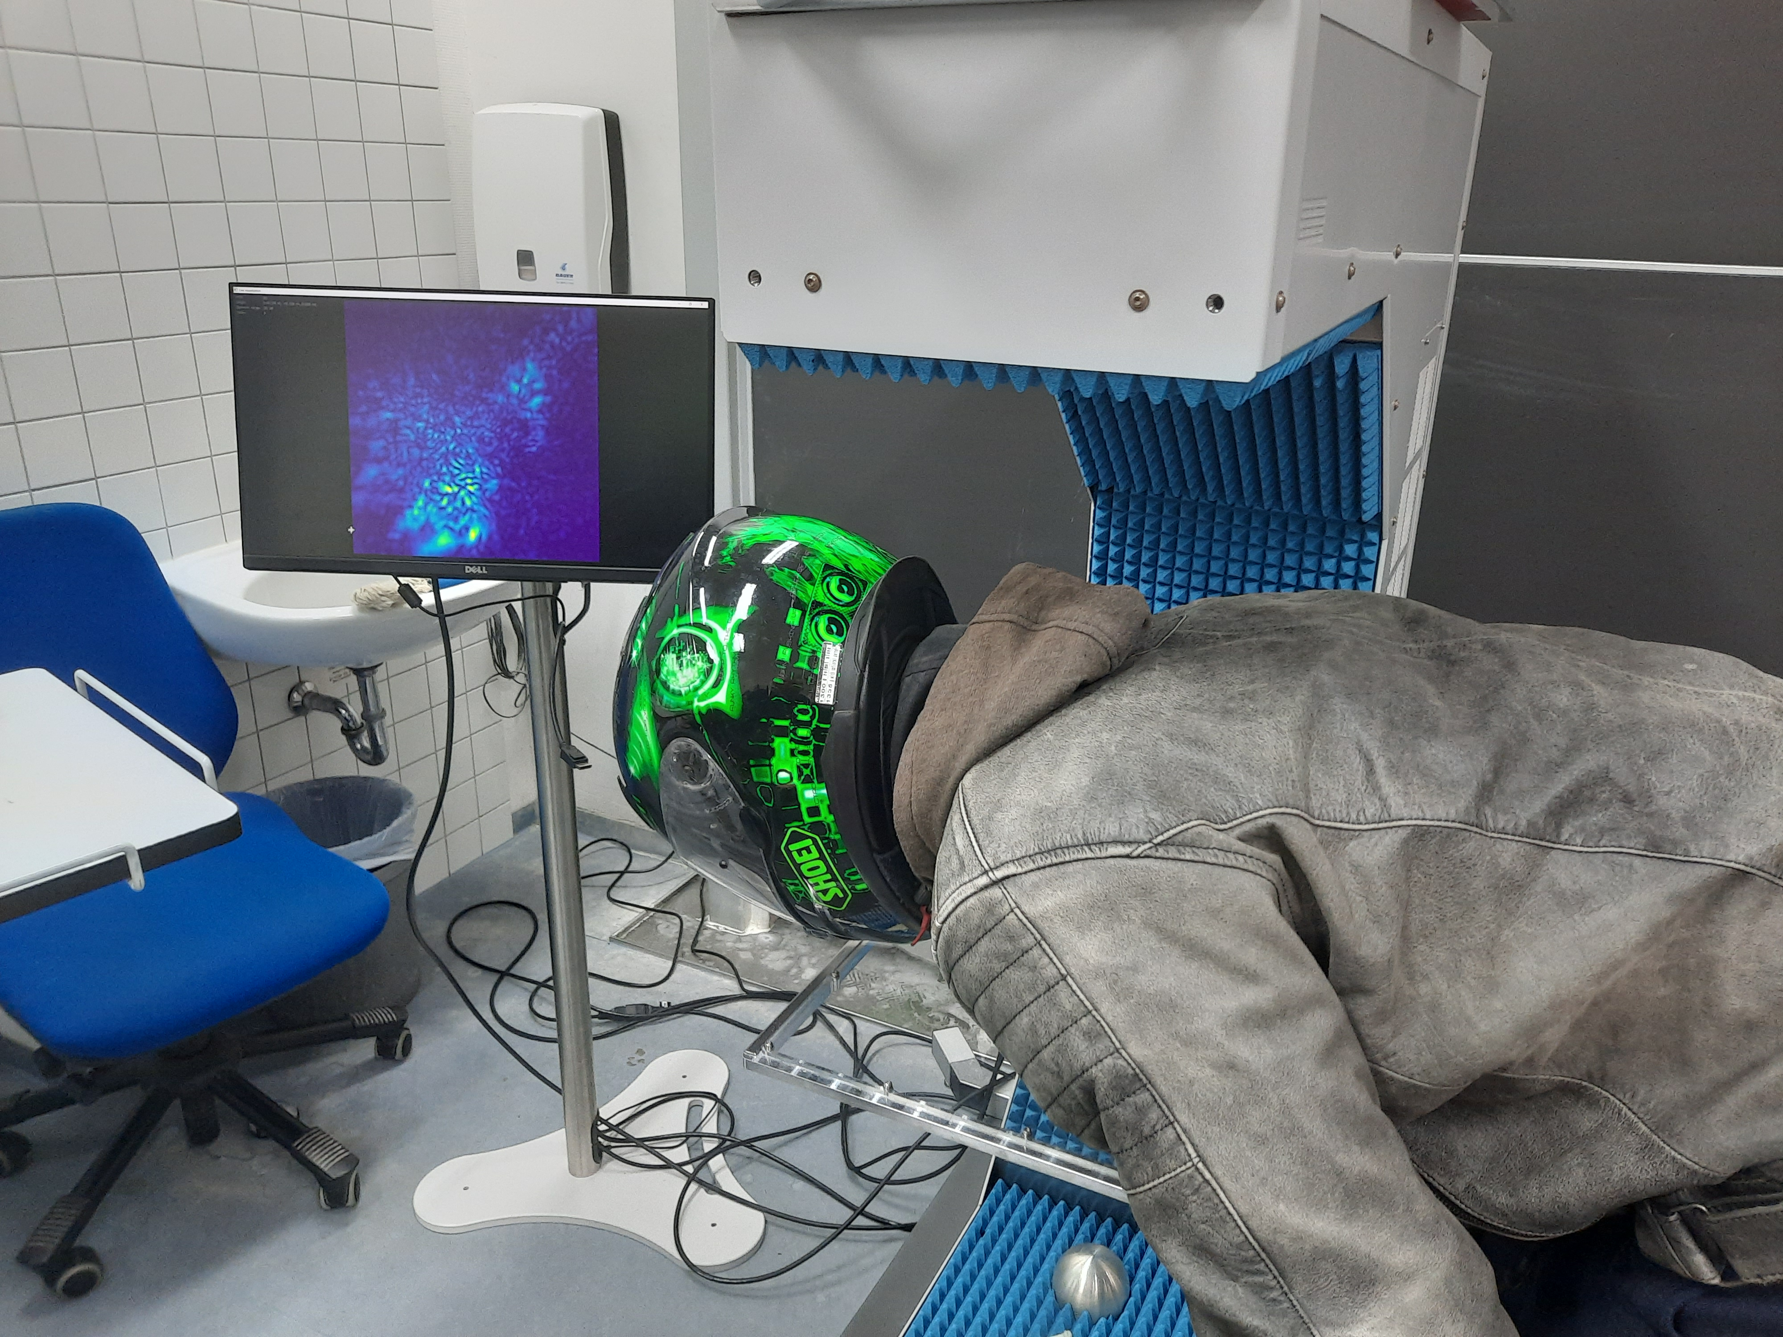
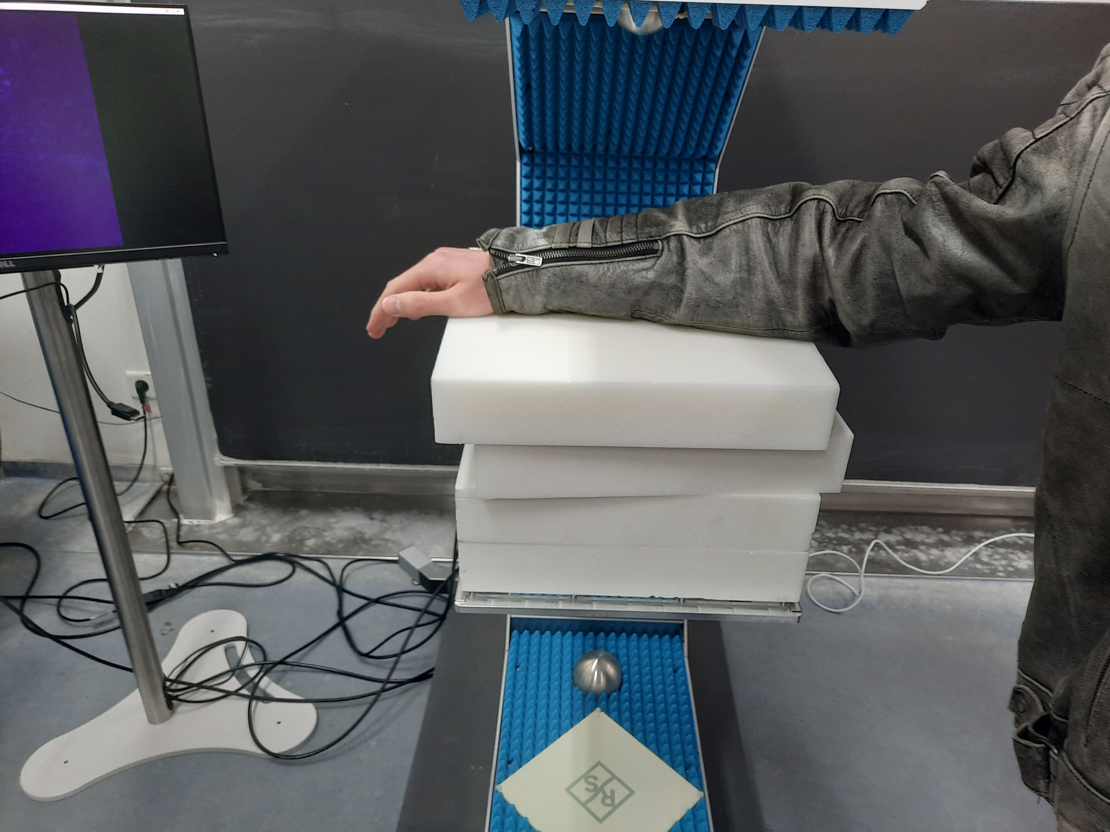
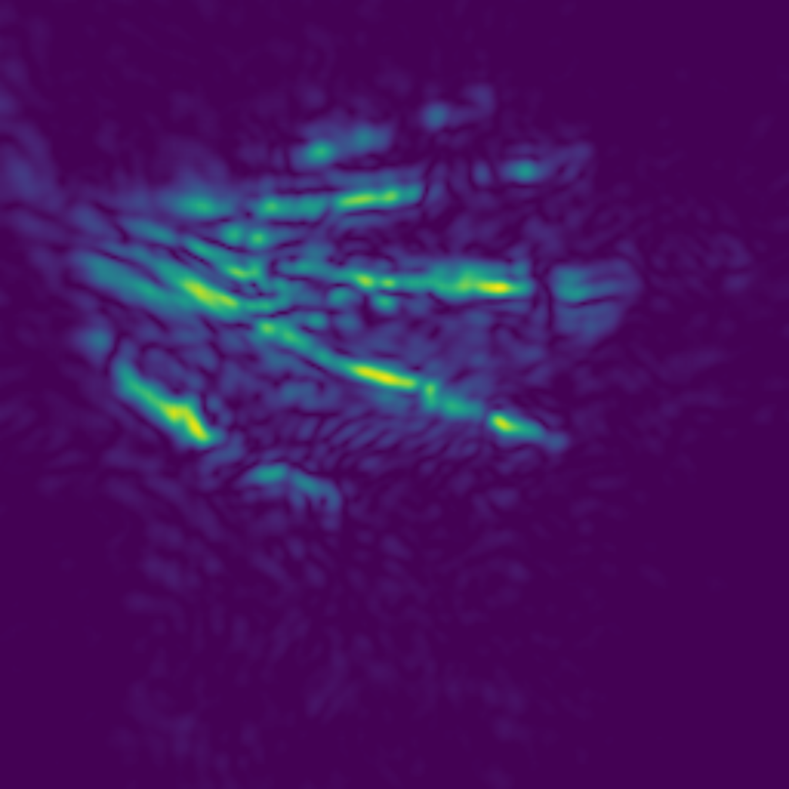
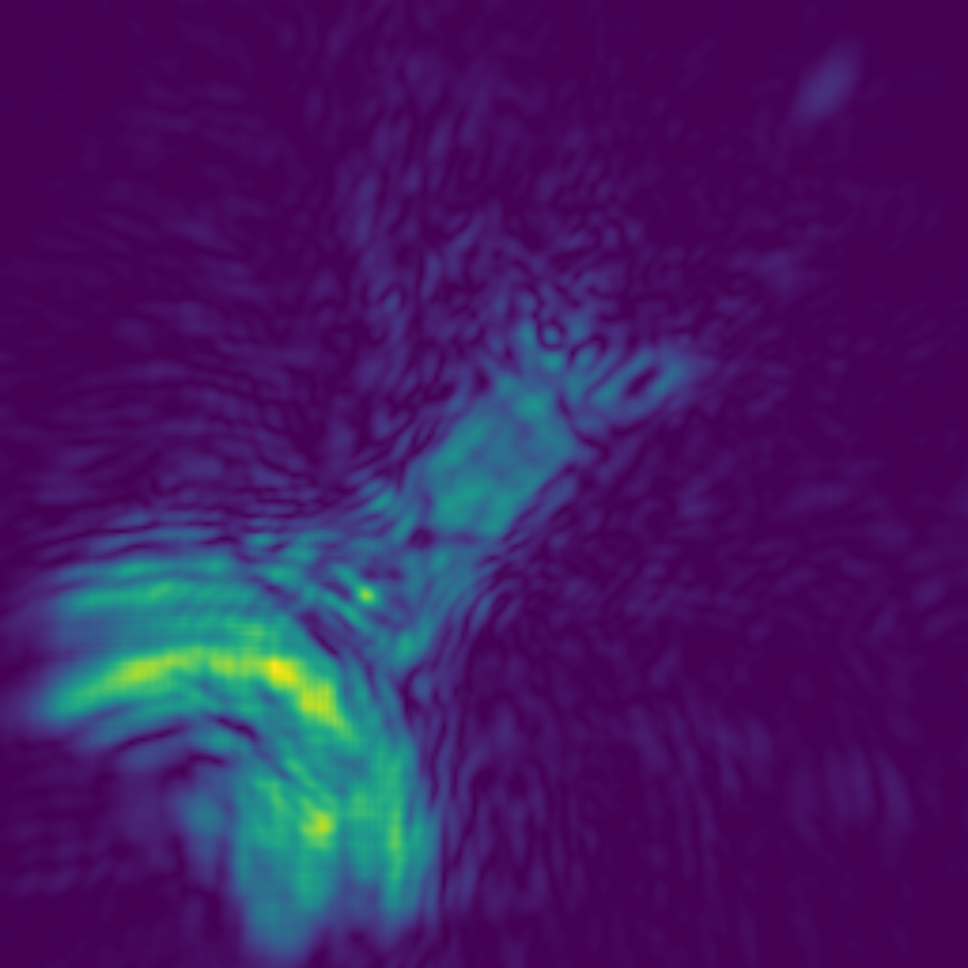
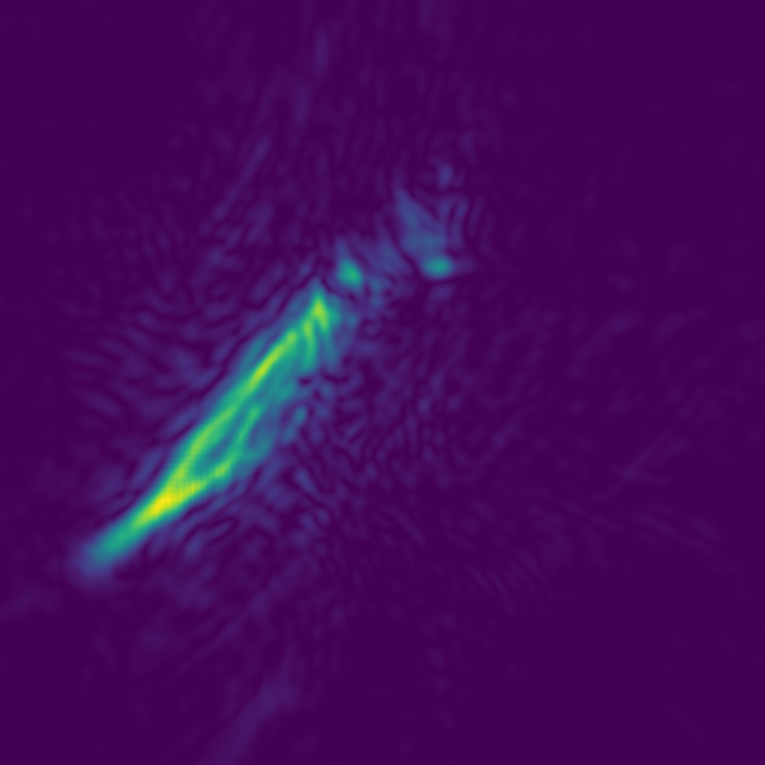

Slide 5
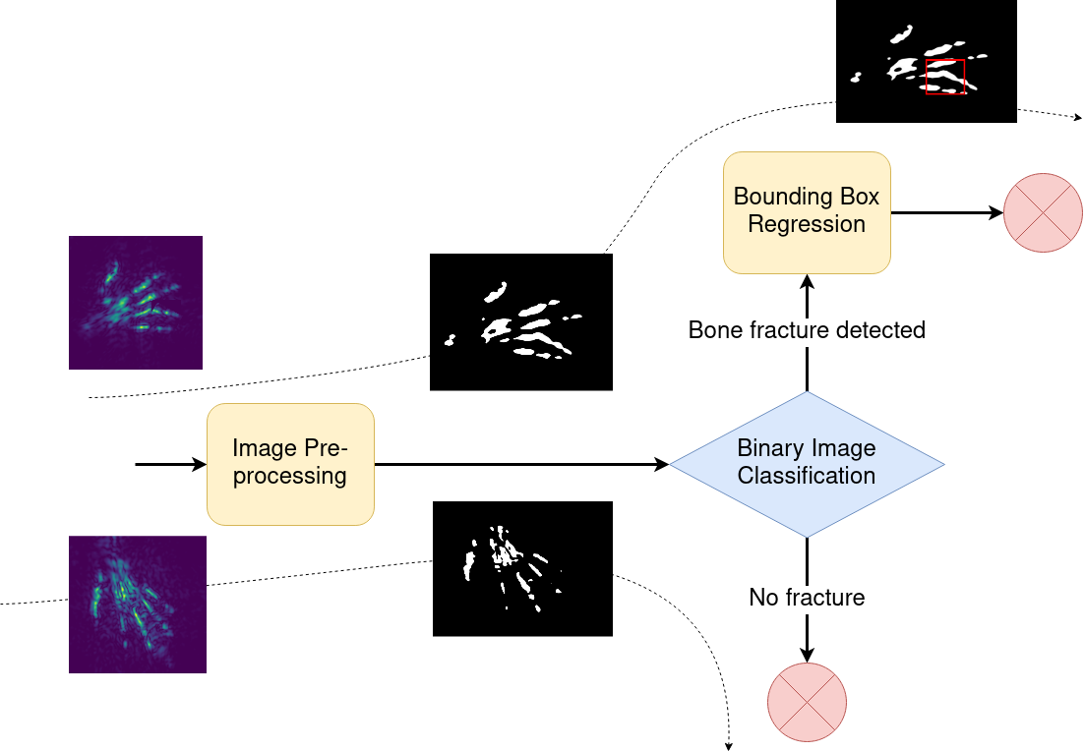
Imagery Process

Slide 6
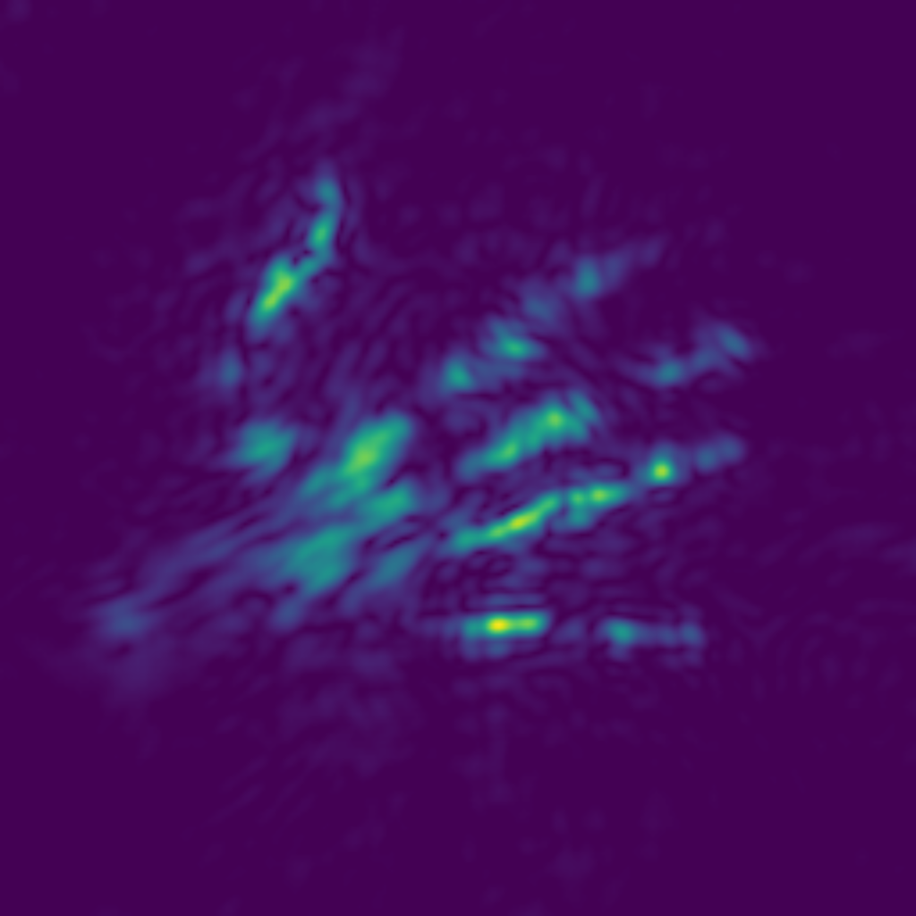




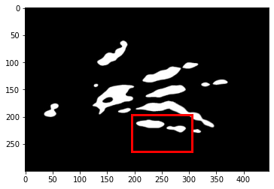
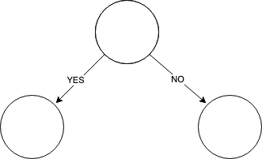
Implementation Details
1. Preprocessing
2. Dataset creation
3. Binary Classification
4. Bounding Box Regression

Slide 7
Implementation Details
Now: Let’s see some code!
Details - https://github.com/oli06/skeleton-hackaTUM

Slide 8
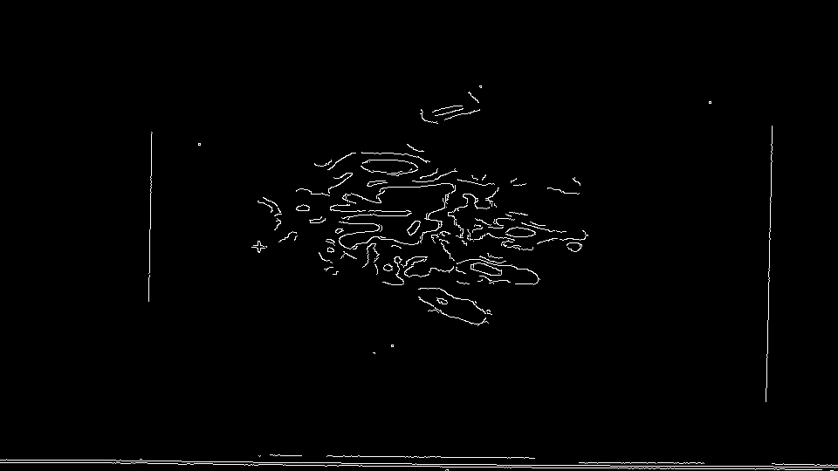
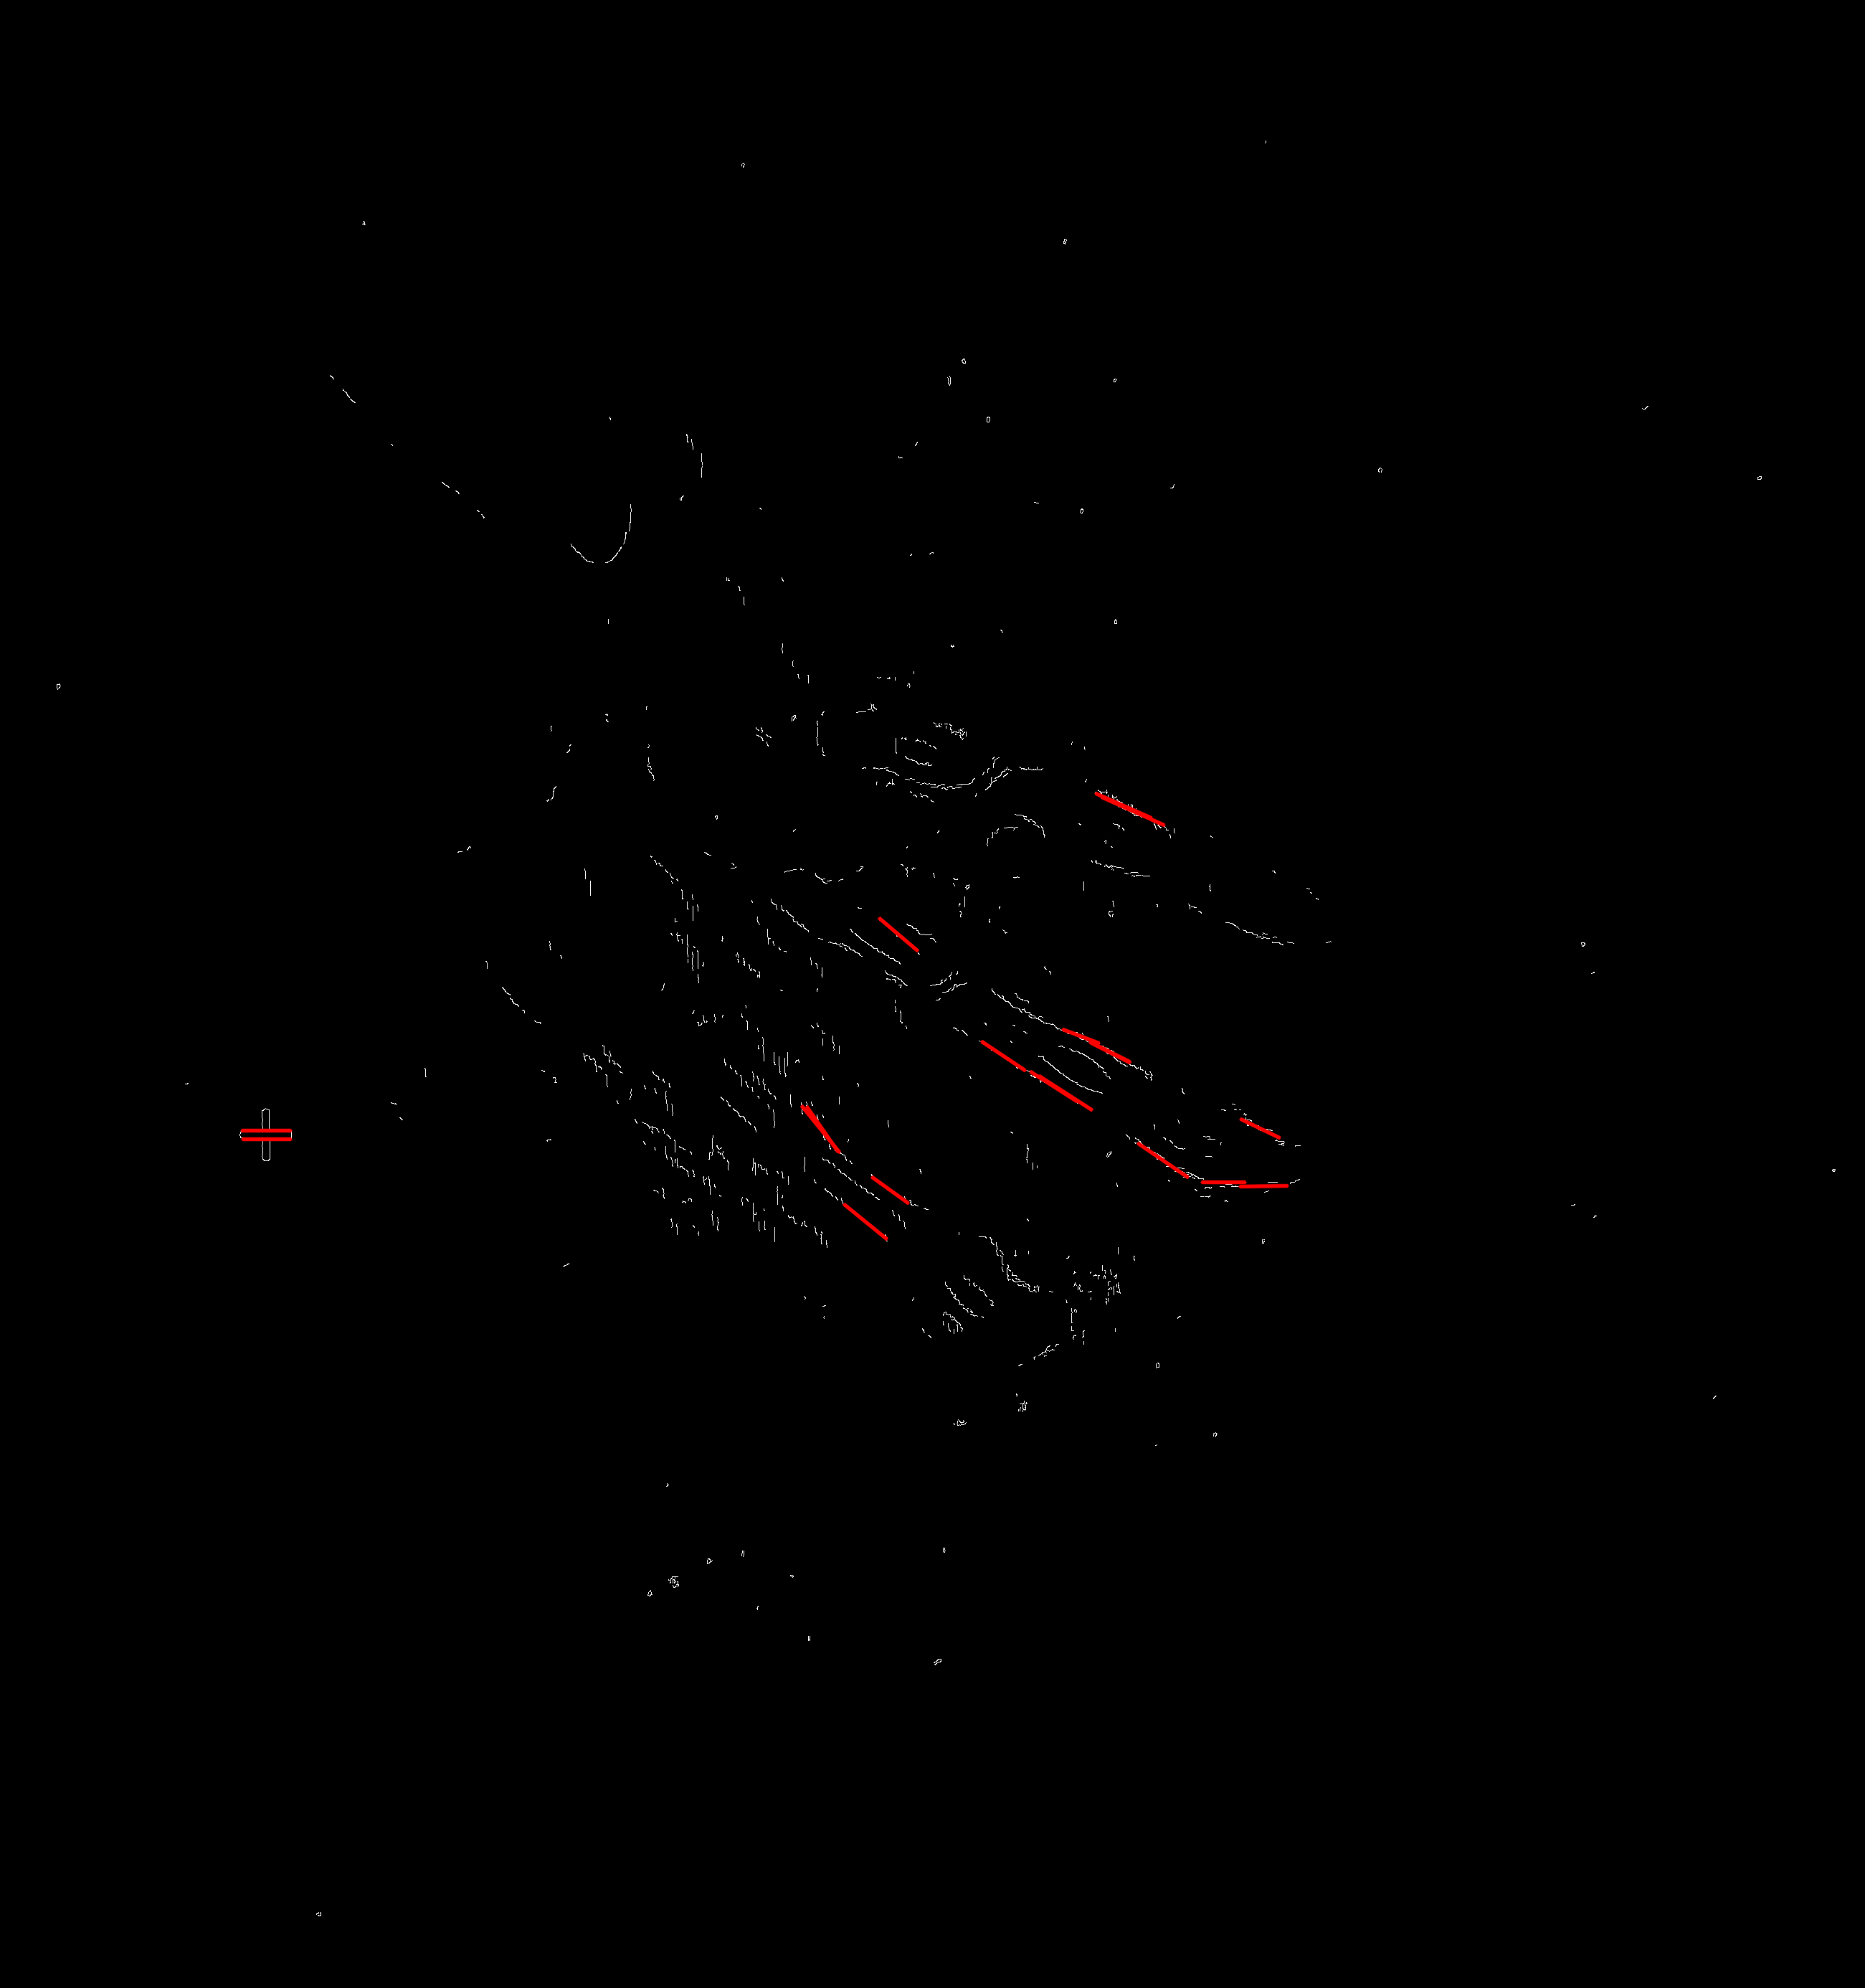
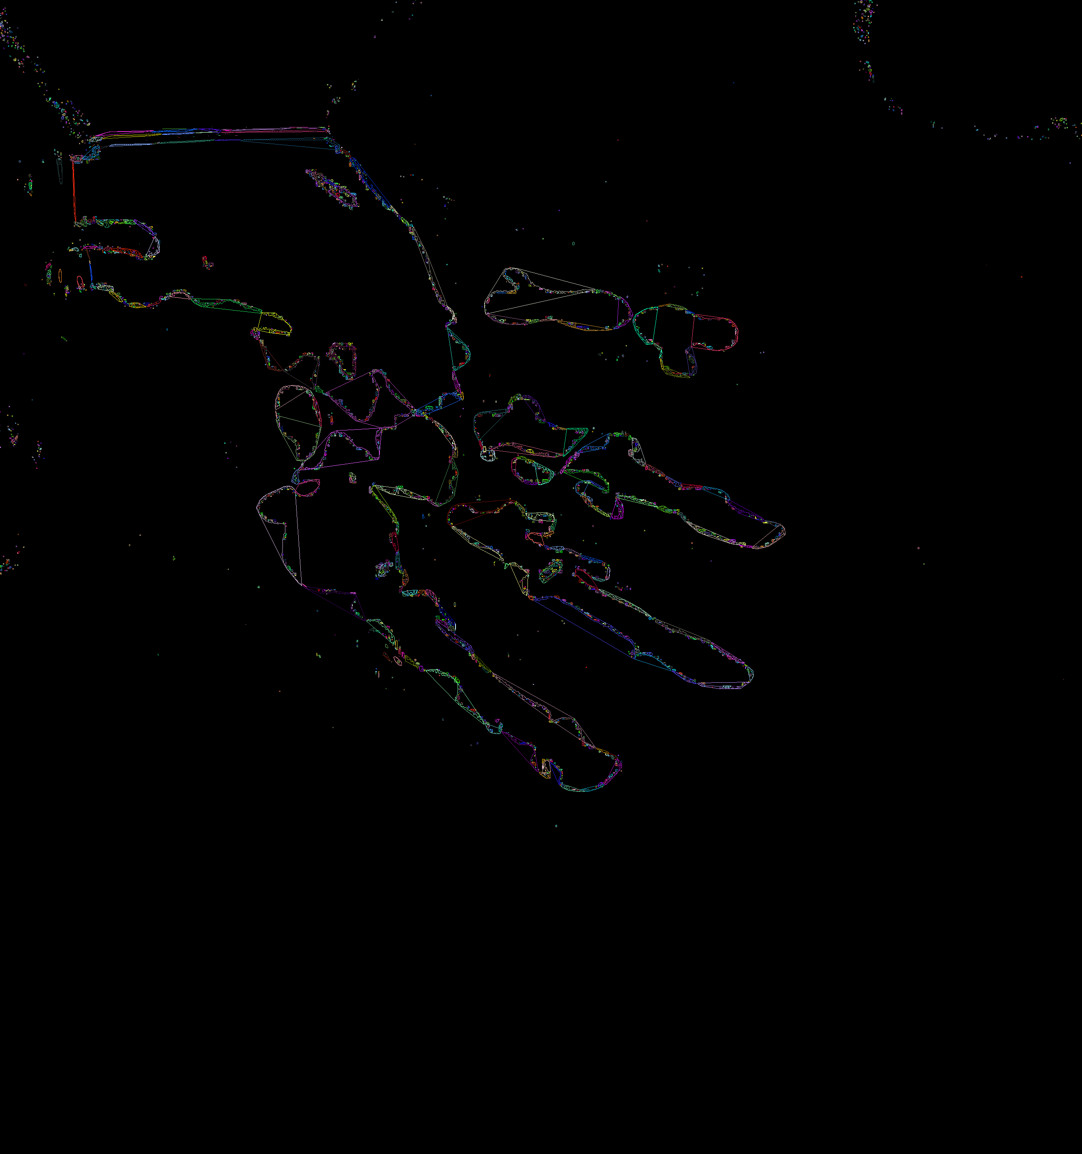

What happened in these 36 hours?
Canny Edge Detection
Probabilistic Line Transform
Convex hull

